Slide 1
IERG 4230 Mini Project Smart Mailing System
(A: 2:30pm - 4:15pm)
GP 17
1155144468 Chan Kwan Chuen
1155144757 Leung Wai Pan

Slide 2
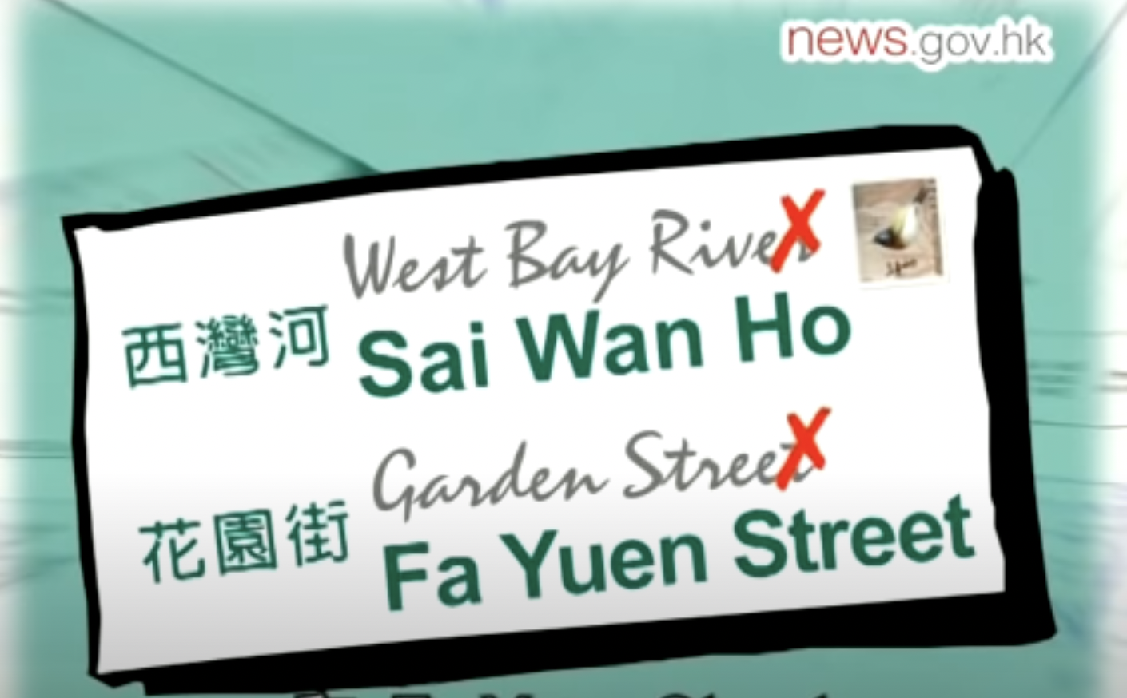
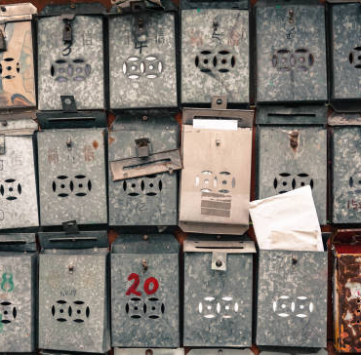
Background
The Post Office handles 1.4 billion pieces of mail each year
Many mails were not successfully delivered to the recipient due to the unknown or incorrect delivery address written by the sender
Mail is lost because the recipient’s mailbox is damaged or human mistakes made from delivering
No detailed delivery records for unregistered mail

Slide 3
Impact
Lower living standard and increase the unnecessary administrative cost due to the unsuccessful mail delivery
Increase the chance of the mail being stolen due to the quality of the mailbox
Personal information leakage problem
Unable to chase the delivery record of the unregistered mail leads to the human sense of insecurity and difficulties of tracking down the missing locations
Not eco-friendly for burning scrapped mails

Slide 4
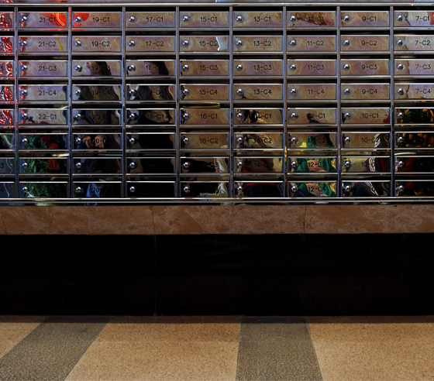
Government Reaction
People are urged to buy mailboxes that have larger space and can be locked
Try their best to clean up the accumulated letters on a regular basis
Promote the importance and method of writing addresses correctly

Slide 5
Our idea
Smart Mailing System with RFID Technology

Slide 6
Smart Mailing System with RFID Technology
Apply the RFID technology into stamps and the whole system to provide automatic real-time data about the letter delivery
Target People: Postman, Hong Kong Citizen
Target Place: Public and private housing estate, Hong Kong Post

Slide 7
Routine Operation
Letter
From Postbox/Airmail
Air Mail Centre
lnternational Mail Centre
General Post Office
delivery office
Postman
Your Home

Slide 8


RFID stamp
Normal stamp
With different value and design
RFID stamp
The cover with different value and design, inside is the mini-RFID chip
It can store data
It can be read by RFID reader

Slide 9
Special feature of RFID stamp
RFID stamp can store different data:
Unique serial number (for distinguishing true stamp)
Face value, remaining value(will be updated by passing every post office)
Sender address, Sender name
Recipient address, Recipient name

Slide 10
Insufficient postage
Normal stamp
Stick more stamps in the envelope or buy larger face value stamp
If forget to do so, penalty required
RFID stamp
No need to worry
The post box gives you a warning
The sender can add value via the "smart post" app (offered by the post office)
If forget to do so, penalty required (paid by app)

Slide 11
Functional Requirement
The location of the letters can be tracked by post office, senders and receivers
The letters can be filtered and sorted by the regions
The address sticker and smart stamp should be generated from a workstation
Address correctness prompts should be given

Slide 12
Non-functional Requirement
The system can be run on mobile, tablet and laptop
Any web browser is allowed for monitoring
The system is in 24/7 and maintenance is operated in mid-night
Aluminum foil is needed for the making material of the post box

Slide 13
Assumptions and Constraints
Server-side
Airmail and Surface mail are using two separated database servers
Post office staff are authorized to monitor the mails sending status
Postbag id carried by specific postman is recorded
Client-side
Pre-written address in mobile is needed for the input in the workstation

Slide 14
Communication and Protocols
Since the RFID stamp cannot connect to the network directly and the RFID reader station is fixed, the communication method is recommended as wired network to connect the server.

Slide 15
Topology
For buildings, an array of mailbox share a RFID reader
For independent user, each RFID reader per house

Slide 16
Power Consumption
Using utility power for sustaining 24/7 service.
Power saving mode, once the post man activate the system, the smart mail system starts to read the RFID and send message to the host.

Slide 17
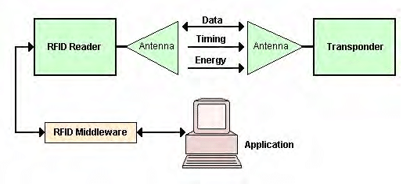
Security Measure
The data in the stamp is encrypted
The RFID stamp can be read by any device, but only the authorized machine can decode the data inside the stamp

Slide 18
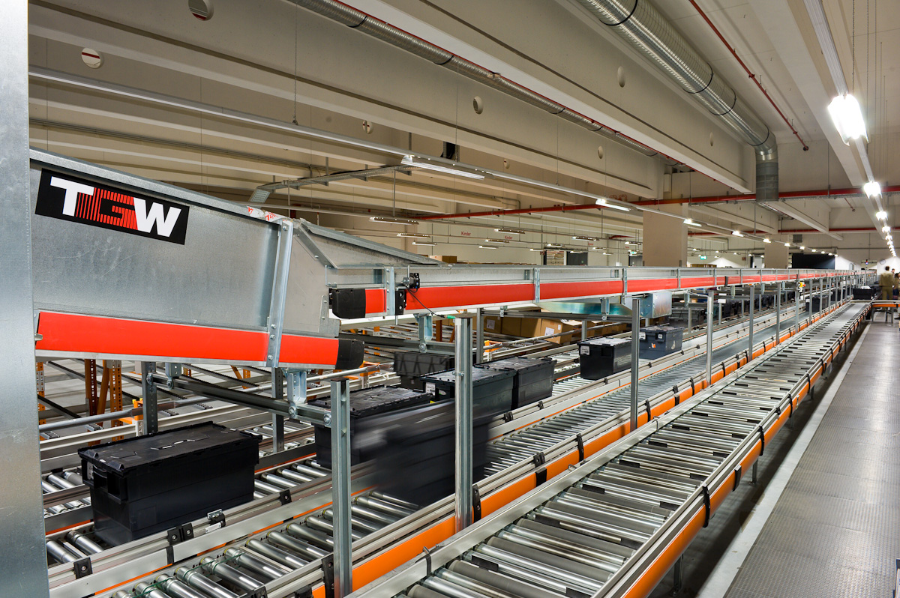
Cost
Post office: RFID stamp system, RFID stamp reader
Each buildings install a smart mail system, including RFID reader, and server for sending mail data for the host.

Slide 19
Benefits
Sender and the post office can trace the mail(current position, estimated arrival time) via the smart mail system
The smart stamp can be recycled it can reduce the cost of publishing the stamp
The efficiency of delivering the mail enhanced, not only the time and also the correctness

Slide 20
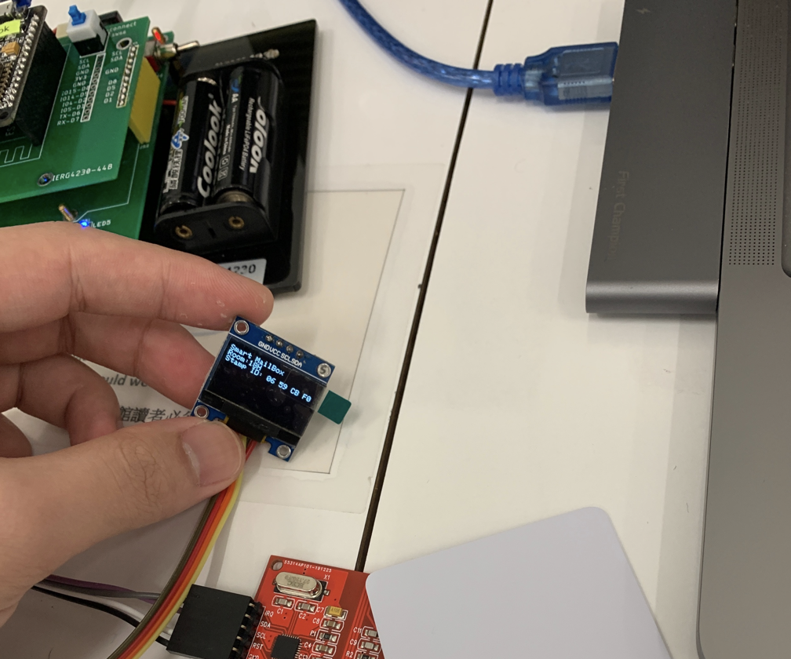
Our Mailbox demo
The little screen installed in the mailbox, the address and the detected stamp ID will be shown.

Slide 21
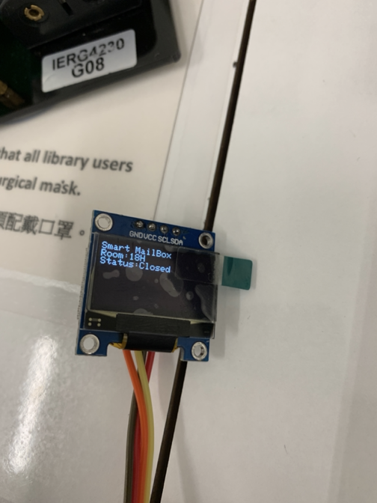
Our Mailbox demo
By default, the smart mailbox is closed. The user can unlock the mailbox by tapping the host card for the mailbox which support RFID function.

Slide 22
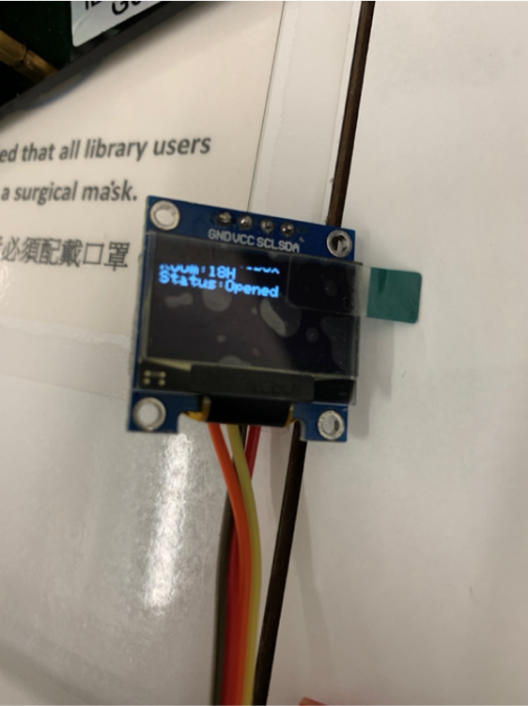
Our Mailbox demo
The smart mail box with RFID function can be unlocked by tapping hostcard.

Slide 23
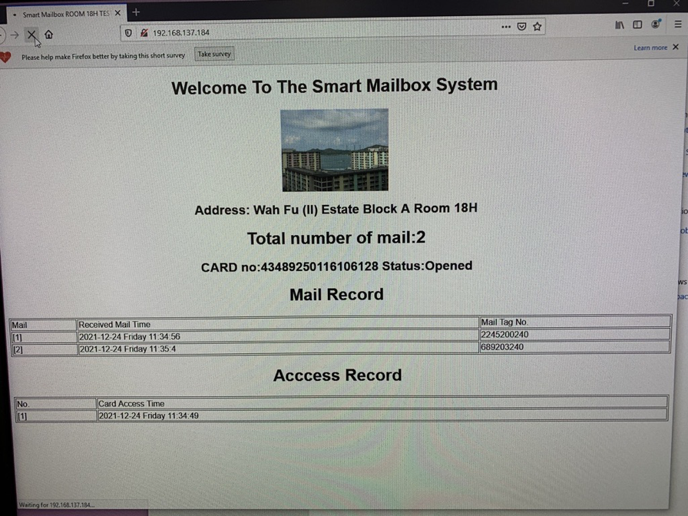
The user can see the mailbox status for checking the mail arrival time and the access record

Slide 24
Future Plan
Embed the blockchain technology to improve data transparency and security
Cryptocurrency will be a new payment method for the postage
Smart Stamp will be beneficial from a systematic management of housing in the space

Slide 25
Reference
https://www.youtube.com/watch?v=ArcKYWzSl58&list=PLdL54zjvpHtfW1ozcH0tCdlJYjMLgXF-3&index=2

